Slide 1
Aligning Values and Evidence: Toward a Measure of Sexual and Reproductive Wellbeing
Notes:
The Coalition to Expand Contraceptive Access (CECA), the National Birth Equity Collaborative (NBEC), and the University of San Francisco, Person-Centered Reproductive Health Program (UCSF), along with a diverse working group, set out to align values and evidence, toward a measure of Sexual and Reproductive Wellbeing (SRWB).

Slide 2
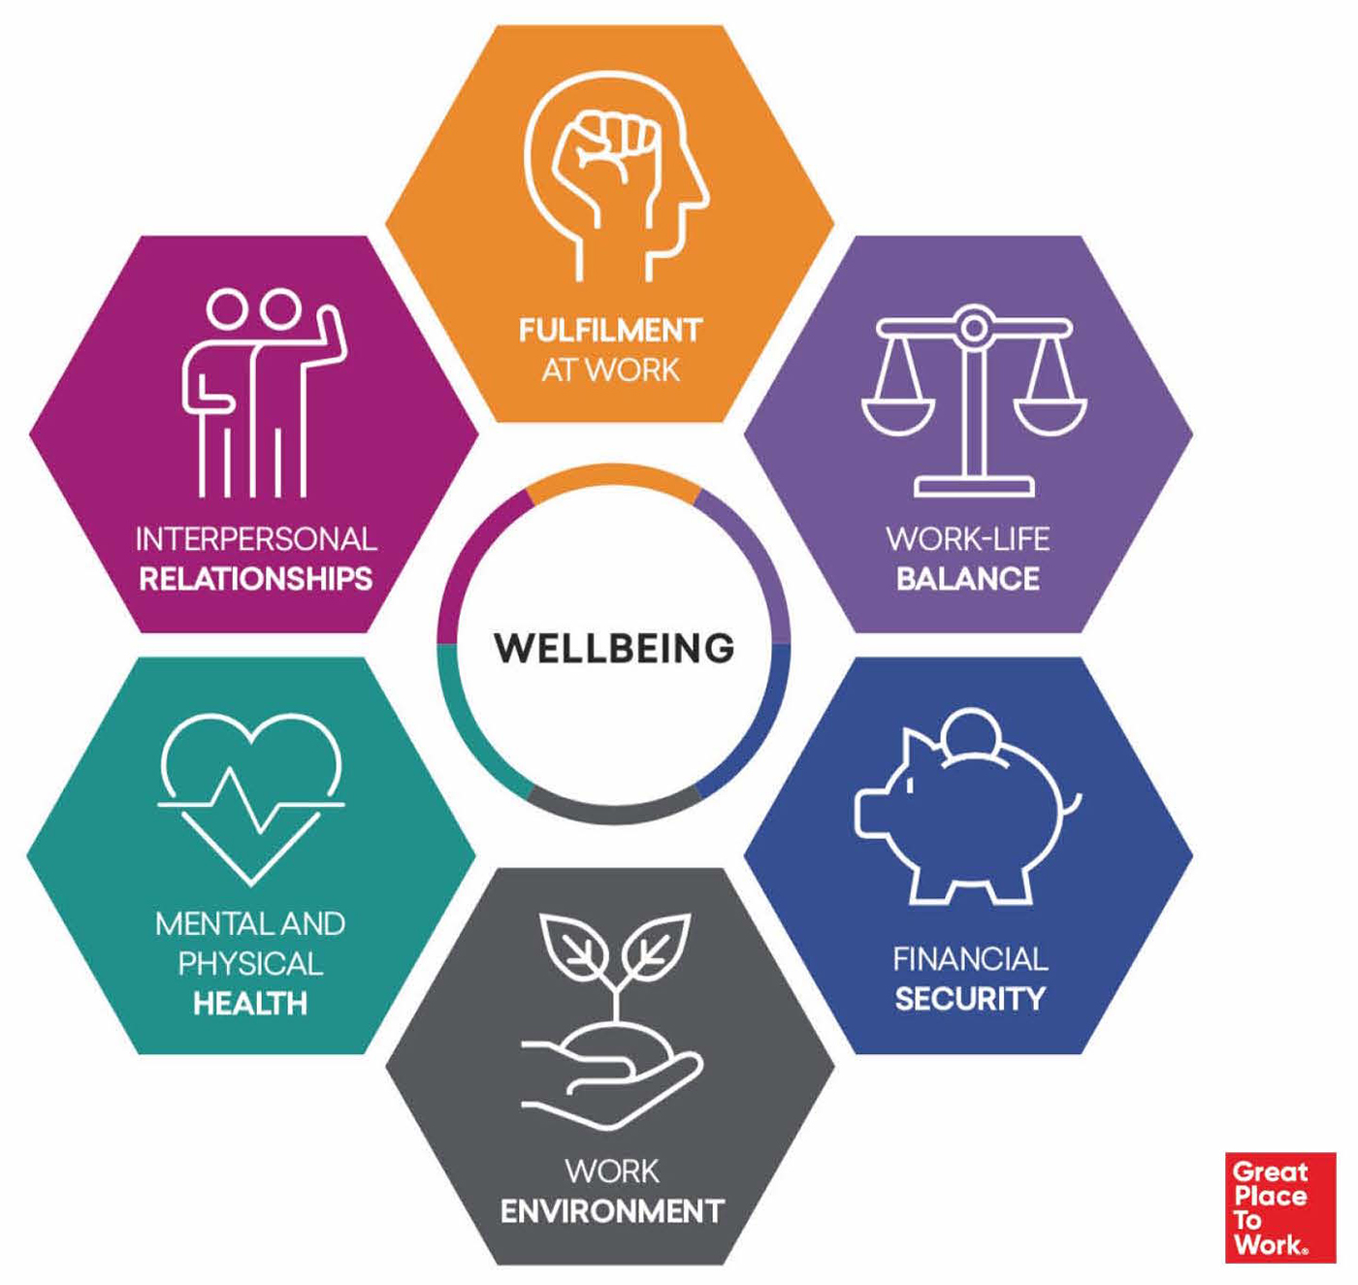
Why consider wellbeing?
Wellbeing is increasingly recognized as a desirable outcome that governments and policy makers should both measure and prioritize
Focusing on and measuring wellbeing moves away from economic measures of societal success to allow decision-makers and funders to consider “what do we really care about? Is it ultimately the wellbeing of citizens?”
Yet wellbeing measures and applications have typically not considered sexual and reproductive experiences and health
Notes:
Wellbeing is a concept of increasing value in the societal and economic space.
Across various countries, including Scotland, New Zealand, and Iceland, we see governments and policy makers shifting toward measuring wellbeing as a desirable outcome – and some considering it as a supplement for GDP.
There is a reason why people are using the wellbeing frame. It allows decision-makers and funders to consider the question: “what do we really care about? Is it ultimately the wellbeing of citizens?”
Yet those measuring wellbeing typically do not consider sexual and reproductive experiences and health (SREH), despite this being a core aspect of wellbeing. Thus, we wanted to integrate the concept of wellbeing with that of SREH.

Slide 3
Wellbeing Frame
“What is non-instrumentally or ultimately good for a person”
Sexual and Reproductive Wellbeing Frame
“People achieving the sexual and reproductive lives they wish to have…lives with abundance and fulfillment”
Notes:
Generally, how we are thinking of wellbeing stems from philosophical literature.
According to the Stanford Encyclopedia of Philosophy, wellbeing in philosophy is most used to describe “what is non-instrumentally or ultimately good for a person”
When this understanding of wellbeing is applied to sexual and reproductive experiences of health, the resulting sexual and reproductive wellbeing frame can be understood as “people achieving the sexual and reproductive lives they wish to have…lives with abundance and fulfillment.”

Slide 4
What is the purpose of the SRWB measurement work?
Produce and disseminate a definition of sexual and reproductive wellbeing (SRWB), and support the development of a strategy to design and validate a self-reported population-level measure of SRWB​
Understand whether people are achieving the sexual and reproductive lives they wish to have
Set the stage for a measure that is values-aligned​
Promote ongoing culture shift in sexual and reproductive health measurement​
Notes:
The purpose of the SRWB measurement work was to produce and disseminate a definition of SRWB and develop a strategy to design and validate a measure of SRWB.
The measure will be self-reported and assessed at the population-level.
With this work, the SRWB team and working group set out to achieve three overarching objectives:
Understand whether people are achieving the sexual and reproductive lives they wish to have,
Set the stage for a measure that is values-aligned, and
Promote ongoing culture shift in SRH measurement.

Slide 5
Why is this work important now?
Current policies, programs, and measurement strategies are inconsistent with a focus on reproductive autonomy and reproductive justice
It is important for us to not reproduce the harms that occurred with previous measurement by keeping values central to and omnipresent in this work
We can also build on the increasing recognition of the value of prioritizing and measuring wellbeing as a means of determining how well people’s health and social needs are met
Notes:
Unintended pregnancy, contraceptive continuation, and abortion rates are examples of normative, non-person-centered measures that nevertheless shape the priorities of sexual and reproductive health policies, programs and care.
These existing measures perpetuate harmful and oppressive narratives that widen inequities in SRH.
There is a fundamental need to shift away from these traditional and often stigmatizing metrics, and toward measurements that are consistent with the vales of reproductive autonomy and reproductive justice.
This work is also an opportunity to builds on the increasing recognition of the value of prioritizing and measuring wellbeing as a means of determining how well people’s health and social needs are met

Slide 6
What principles guide this work?
How do we center justice and equity and ensure the measure definition and development process is inclusive, values-aligned, evidence-based, and does not reproduce harms?
Keep values central and omnipresent in this process
Define SRWB in the “eye of the beholder” and across the life course
Rely on diverse community engagement
Move away from negative definitions and toward a positive framing
Reiterate the importance and unique contribution of holistic measures, like SRWB
Build from but do not be constrained by previous measurement approaches
Notes:
The SRWB team and working group identified and modeled the following principles from the outset of this effort. These principles, informed by environmental scanning efforts and expert input, were identified as key to centering justice and equity and ensuring the process is inclusive, values-aligned, evidence-based, and does not reproduce the same harms as prior measurement approaches. They include:
Keeping values of RJ and SRHE central and omnipresent throughout this process​: Rooting the SRWB measure and development process in concrete values and goals, from the point of conceptualization and throughout implementation.
Defining SRWB “in the eye of the beholder”: Recognizing that everyone has different lived experiences, desires, and stigmas and is impacted differently by policy and structural contexts, and keeping that in mind as we strive to incorporate how individuals understand and define their subjective wellbeing across the life course, while working toward a population-level measure.
Relying on diverse, comprehensive community engagement​: Accepting that measure developers alone should not define wellbeing for all individuals; and thus developing an inclusive, validated definition and measure through community feedback and qualitative information gathering.
Moving away from negative definitions and toward a positive framing: Several existing health-related concepts are defined in the negative, including by the absence of illness or problem. Therefore, we aimed to focus SRWB on positive elements, emphasizing the positive outcome of wellbeing, as well as influential components along the pathway.
Reiterating the importance and unique contribution of holistic measures, like SRWB​: This includes framing why SRWB measurement is needed and clarifying its intended use throughout discussions, development, and dissemination to emphasize the potential positive impacts and promote culture shift.
Lastly, building from but not being constrained by previous measurement approaches:​ Measures have their limitations and risk being weaponized. It is important to consider both traditional and innovative approaches to measure development to reimagine their value and utility and not recreate prior harms.

Slide 7
Phase 1: Progress to Date
What have we achieved?

Slide 8
Moving Toward a Measure of Sexual and Reproductive Wellbeing
Where we are now….
(with diverse workgroup input and reviews of the evidence)
Step 1. Identify the idea we would like to measure and develop a conceptual framework
Step 2. Develop a detailed definition of the idea and a measurement framework
Enhanced communication, collaboration, and alignment
Phase 1
….And in the future
(with additional qualitative work and community engagement)
Step 3. Refine the definition and measurement framework
Step 4. Draft a preliminary instrument
Step 5. Test and refine the instrument and develop recommendations for use
Phase 2
Notes:
This slide outlines the key steps that comprise the two phases of this work.
Phase 1 reflects the work completed to date, comprising of two steps:
Developing the idea and conceptual framework, and
Developing a detailed definition and measurement framework
*This work was informed by diverse workgroup input and reviews of the evidence; it also led to enhanced communication, collaboration, and alignment. We will dive more deeply into these steps momentarily.
Phase 2 reflects future measure development work and consists of:
Refining the definition and measurement framework
Drafting a preliminary instrument
Testing and refining the instrument and developing recommendations for use
* This work will be driven by additional qualitative research and community engagement.
We will start by focusing on what we have accomplished in Phase 1 (Steps 1 & 2), and move onto what we hope to achieve in the second phase of this work (Steps 3-5).

Slide 9
What did we learn?
Themes from qualitative literature about core components of sexual and reproductive wellbeing:
Existing quantitative measures:
Prioritize clinical and public health objectives and frames
Have limited scope and are centered on the experiences of cis-women and heterosexual relationships
Are limited to symptom inventories and psychological distress/disorders, even for more holistic conceptualizations
Of overall wellbeing are incomplete and inconsistent
Sexual and reproductive agency and autonomy
Person-centered sexual and reproductive care and services
Personal and interpersonal experiences
Notes:
In phase 1 we performed two environmental scans of SRWB-related quantitative and qualitative literature to understand the existing published evidence.
We learned that existing quantitative measures…
From the qualitative literature, we identified themes about the core components of SRWB. These include…

Slide 10
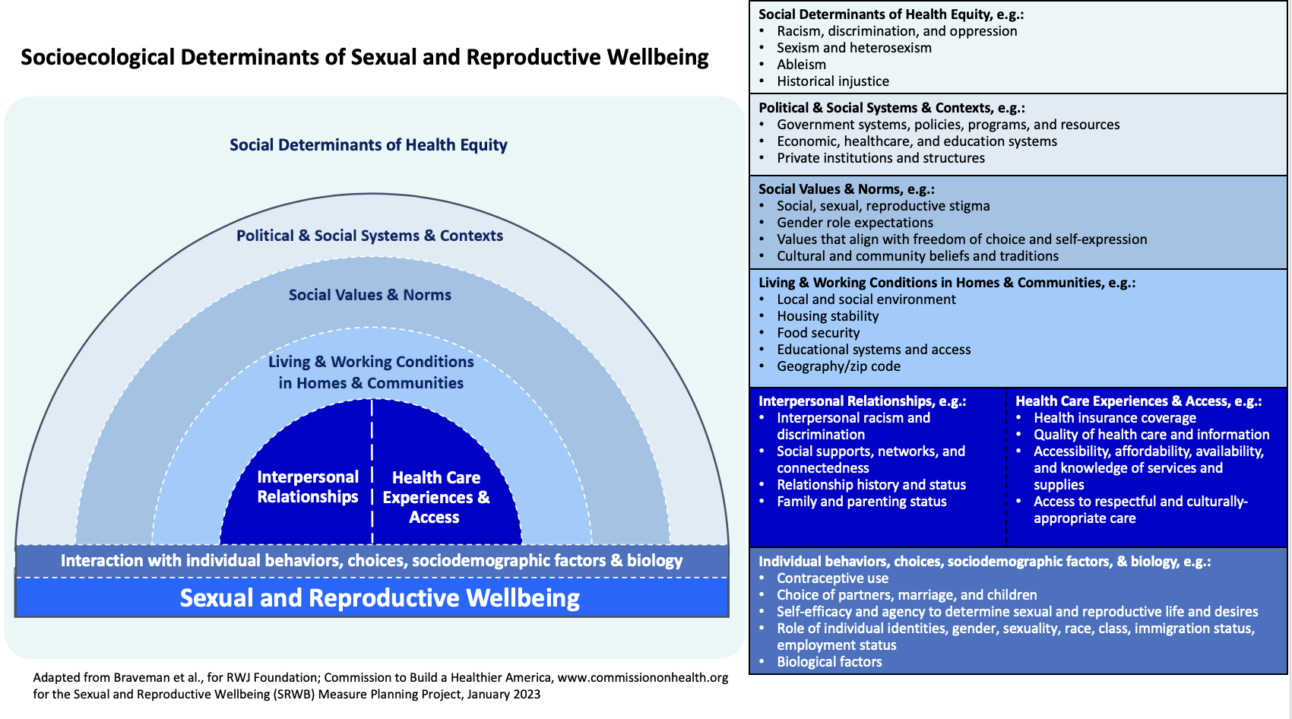
What is our conceptual understanding of SRWB?
Notes:
Before developing a definition for SRWB, it was important to understand the broader sociological determinants and context that inform the concept of SRWB
In order to make this context explicit, we developed a conceptual model of SRWB, informed by input from the workgroup plus learnings from the environmental scans.
This graphic is adapted from a socioecological model developed for the Robert Wood Johnson Foundation. It proposes the socioecological factors and context that constitute SRWB and influence people’s ability to achieve SRWB, including how structural, social, and individual-level determinants directly and indirectly shape the outcome of SRWB.
The social determinants of health equity are intentionally illustrated as a “sea” in which this model “swims” to demonstrate how systems of power and history pervade all societal structures, policies, practices, values, choices, and, ultimately, SRWB. Being explicit about the relationship between SRWB and these social determinants of health equity and the socioecological determinants included within the model helped ensure that the development of a definition of SRWB and its domains was informed by contextual factors.

Slide 11
How are we (initially) defining SRWB?
SRWB is a state of complete physical, mental, and social fulfillment in all matters related to sex and reproduction, free of injustice, oppression, coercion, violence, and stigma and their consequences. This includes having:
Freedom and ability to control, act on, and not act on one’s sexual and reproductive decisions, desires, goals, and identities, including having comprehensive information, services, and supports, and not being hindered or harmed
Holistic and high-quality care for one’s sexuality and reproduction, free of judgement and bias, and coercion, that prioritizes personal needs and desires
Optimal sexual and reproductive outcomes in accordance with one’s needs and desires, including:
Attaining one’s ideal level of sexual and reproductive health
Having the choice of if, when, and how to become a parent, and ability to do so
Having a pleasurable and safe sex life
Notes:
The SRWB team and working group developed an initial definition of SRWB through an intensive stakeholder engagement process, iterated across multiple workgroup meetings. Existing evidence on people’s experiences and understanding of their SRWB, the socioecological factors that shape and comprise SRWB, existing SREH definitions and measures, and RJ and SRHE frameworks informed its development.
By ‘initial’ we mean that this definition is not static – it will evolve with more input from stakeholders and as it’s applied to different communities.
We were intentional about creating a broad definition so that it can be applicable to all people and across the life course.
We envision the definition to be taken up and considered by the broad SREH field and eventually the general population to begin changing how people think about sexual and reproductive outcomes, including their own sexual and reproductive outcomes. This definition is also an avenue through which to shape and direct the SREH narrative, policy, and practice.

Slide 12
Which domains are (initially) included in the measurement framework?
Satisfaction with your sexual and reproductive experiences
Agency, autonomy, and freedom from oppression in matters related to sexuality and reproduction
Experience of sexual and reproductive health care
One’s ideal state of sexual and reproductive health
The choice of if, when, and how to become a parent, and ability to do so
A pleasurable and safe sex life
Notes:
The SRWB team developed an initial measurement framework for SRWB, building off of the draft definition.
The measurement framework distills our conceptual definition of SRWB into an operational definition, or list of initial proposed domains, to help guide measure development, including item generation.
The final SRWB measure may diverge from this framework, as:
Subsequent qualitative work and testing may shift domain organization, item inclusion, and more
The broad approach leaves room for further refinements or adaptations by future researchers

Slide 13
Phase 2: Looking Ahead
Where do we go from here?
Notes:
Moving onto Phase 2, of this work – what do we hope to achieve looking ahead?

Slide 14
Moving Toward a Measure of Sexual and Reproductive Wellbeing
Where we are now….
(with diverse workgroup input and reviews of the evidence)
Step 1. Identify the idea we would like to measure and develop a conceptual framework
Step 2. Develop a detailed definition of the idea and a measurement framework
Enhanced communication, collaboration, and alignment
Phase 1
….And in the future
(with additional qualitative work and community engagement)
Step 3. Refine the definition and measurement framework
Step 4. Draft a preliminary instrument
Step 5. Test and refine the instrument and develop recommendations for use
Phase 2
Notes:
Moving toward a measure of SRWB, our second phase will fundamentally require additional qualitative work and community engagement to move into instrument development and testing.

Slide 15
What is next in the SRWB measure development process?
Step 3: Refine the definition and measurement framework
Engage diverse communities to ensure definition and framework reflect and align with people’s perspectives and experiences
Consider context-specific modifications with one group (e.g., trans men or individuals with physical disabilities)
Step 4: Draft a preliminary instrument
Generate items with guidance from measurement experts, SREH technical experts, and community members
Conduct cognitive interviews to test items for clarity, equivalence, and comprehensiveness
Step 5: Test and refine the instrument and develop recommendations for use
Conduct validity and reliability testing of the item pools with large, diverse participant pool
Develop guidelines and best practices for dissemination and implementation
Conduct stakeholder and community engagement
Notes:
Next in the SRWB development process is to:
Refine the definition and measurement framework (Step 3)
Draft a preliminary instrument (Step 4)
Test and refining the instrument and developing recommendations for use (Step 5)
We are thinking about and conducting this process differently from other measure development approaches by asking people about how they want us to phrase the items etc., in addition to iterating our current definition and measurement framework of SRWB.

Slide 16
How will qualitative work and community engagement inform the project?
Step 3: Refine the definition and measurement framework
Conduct interviews and other stakeholder discussions to:
Step 4: Draft a preliminary instrument
Conduct cognitive interviews with a representative sample of different populations to:
Step 5: Test and refine the instrument and develop recommendations for use
Conduct a stakeholder-engaged consensus building process to:
Ensure intentionality in defining, identifying, and engaging communities – and prevent unintentional exclusion
Learn from participants impressions, perspectives, and experiences about the measure, the items, and specific concepts related to SREH and wellbeing to refine/revise the item pools
Ensure that testing is representative of and relevant for all communities included in the dataset(s) and considered in the measure
Iteratively test items to ensure that important domains, concepts, or experiences have not been missed or misunderstood in the measure
Iteratively explore the wording/interpretation of the domains and questions
Ensure that a wide range of potential stakeholders, including communities, can utilize this tool to collect data and better understand people’s SRWB
Notes:
In this next phase of the SRWB project, qualitative work and community engagement will be critical to inform the measure development process.
Different from other measure development processes, the SRWB approach plans to include qualitative work and community engagement efforts to elicit and incorporate feedback on the proposed definition, framework, items, and measure – including participating in measure testing activities and developing recommendations for measure use.
This involvement will be essential to developing a responsive, community-informed person-centered measure

Slide 17
How might an SRWB measure be useful outside of the US?
While initial work focused on the US, the need for holistic measures is clearly relevant in broader global context as well
Need to consider how different structures, systems of health care, and social and cultural norms may influence how SRWB is defined and understood
Have funding to support stakeholder engagement to consider how the definition and measurement strategy of SRWB may relate to diverse global contexts and how to adapt US-focused work
Notes:
Outside the US, and particularly in countries often called low- and middle-income or “the Global South”, there are similar if not greater challenges with existing measures, including the reliance on measures related to contraception such as “unmet contraceptive need” and “modern contraceptive prevalence ratio” that do not consider or incorporate people’s own preferences and goals related to fertility and contraceptive use.
Therefore, the need for holistic measures is relevant beyond the US.

Slide 18
What are the potential impacts of measuring SRWB?
Uplift people’s values, expand access, and address inequities
Increase focus on values-aligned, holistic, and person-centered metrics at the core of policy, programs, practice, and research
Disrupt historical measurement approaches and avoid reproducing the harms of prior measurement
Increase understanding of the extent to which structures, systems, and the range of fields and efforts are enabling optimal sexual and reproductive experiences on a population level​
Contribute to our ability to empirically assess, better understand, and more effectively address complex phenomena going forward
Notes:
New and improved measures, like SRWB, can be used to better capture people’s own lived experiences of SREH.
Measuring SRWB has the potential to:
Uplift people’s values, expand access, and address inequities;
Increase focus on values-aligned, holistic, and person-centered metrics at the core of policy, programs, practice, and research;
Disrupt historical measurement approaches and avoid reproducing the harms of prior measurement;
Increase understanding of the extent to which structures, systems, and the range of fields and efforts are enabling optimal sexual and reproductive experiences on a population level​; and
Contribute to our ability to empirically assess, better understand, and more effectively address complex phenomena going forward
This effort to define and measure SRWB can help drive a fundamental and holistic shift toward person-centered metrics through documenting and sharing the work, engaging key partners, and fostering action.

Slide 19
How do we foster and continue collaboration?
Continue to engage with interested working group members
Engage community members for input on the SRWB definition, framework, and draft SRWB measure, and in measure testing activities
Work with measurement and other interested partners to develop additional relevant metrics in US and global contexts
Build broader stakeholder support by tailoring outreach efforts to varied audiences
Notes:
Collaboration is key to creating a fundamental shift to person-centered metrics that center people’s values and preferences for sexual and reproductive experiences and health.
We also see collaboration as key to moving the SRWB measure development process forward and to collectively creating a “SRWB narrative” that fosters buy-in for measure dissemination and implementation. To that end, the SRWB team intends to:
Continue to engage interested working group members, throughout the measure development phases (steps 3-5) and during the dissemination and implementation phases.
Engage community members to help refine and finalize the SRWB definition and measurement framework, provide feedback on the draft quantitative measure of SRWB, and participate in measure testing activities.
Work with measurement and other interested partners to identify and develop additional metrics related to SRWB and to consider application of SRWB in other global contexts.
Build broader stakeholder support by tailoring outreach efforts to audiences such as human rights advocates and federal partners, including those who manage national survey systems.

Slide 20
Who are the convening partners?
CECA CECA is a convener of committed partners working to ensure access to contraception as part of a broader vision to achieve sexual and reproductive health equity (SRHE) for the U.S. CECA focuses on identifying the evidence needed to influence policy, leveraging federal executive branch processes, and setting the stage for implementation.
National Birth Equity Collaborative (NBEC) is a nationally recognized organization focused on shifting the culture within public health and health care to create an equitable and respectful environment of care for all women, birthing people, and their babies. With a focus on racism as a root cause of health and birth inequities for Black women, NBEC works in partnership with communities and providers, equipping them with thoughtful tools to catalyze change.
The Person-Centered Reproductive Health Program (PCRHP) is a research program, through UCSF, that aims to advance reproductive autonomy and wellbeing by conducting research and designing programs that center people’s experiences and preferences for sexual and reproductive health and health care, guided by an attention to the intersecting oppressions and structural injustices that impact people’s lives and health.
Notes:
This slide presents information on the three partners that comprise the SRWB Team.

Slide 21
Thank you!
Any questions? Please contact:
CECA@contraceptionaccess.org

